Slide 1

Development of a model order reduction library for an Android-based FEM app
Berkay Alp Cakal
Oguzhan Karakaya
Manuel Meßmer
Technische Universität München
Software Lab 2018
Civil, Geo and Environmental Engineering
Munich, 29. May 2018

Slide 2
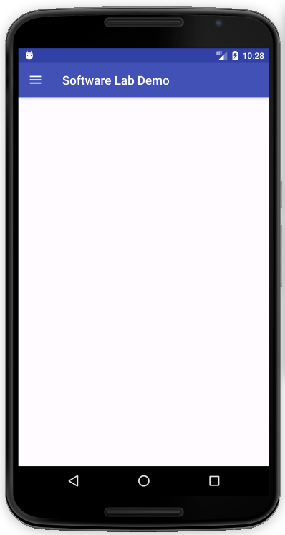


Why using FEM on a Smartphone?
Two Major Fields of Application
Teaching Tool
Helps students to understand the workflow of FEM
Solutions can be obtained easily
Portable Computational Support
Analyse structure on site
Provides first rough estimation of the problem
www.Colourbox.de
www.Colourbox.de

Slide 3
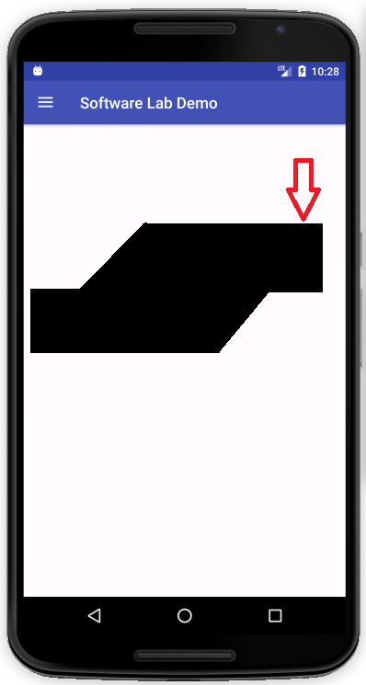
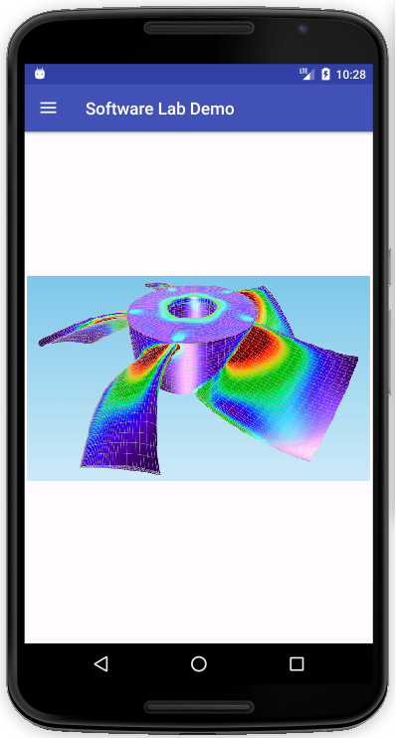
What is a Smartphone capable to do?
Handle easy Computations
Handle more complex Computations
Model Order
Reduction

Slide 4
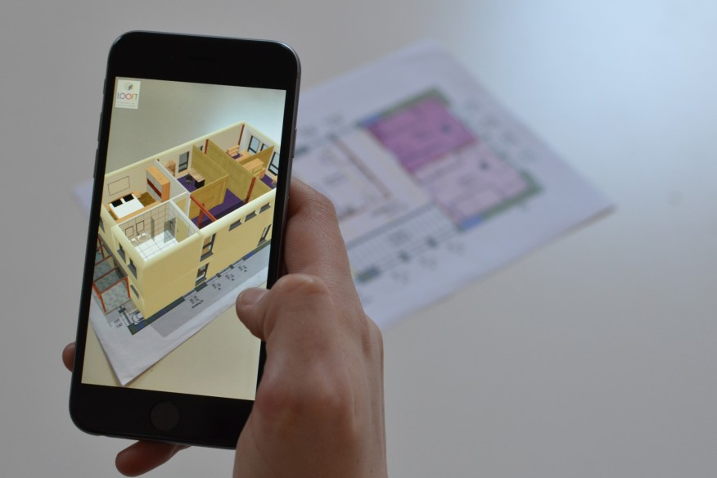
What is a Smartphone also capable to do?
We could add fancy features like…
Making use of built-in sensors ( camera, rotation sensor, barometer, ambient light sensor etc. )
Using Augmented Reality
E.g. Recognize easy truss systems
This is Future…
www.architectmagazine.com

Slide 5
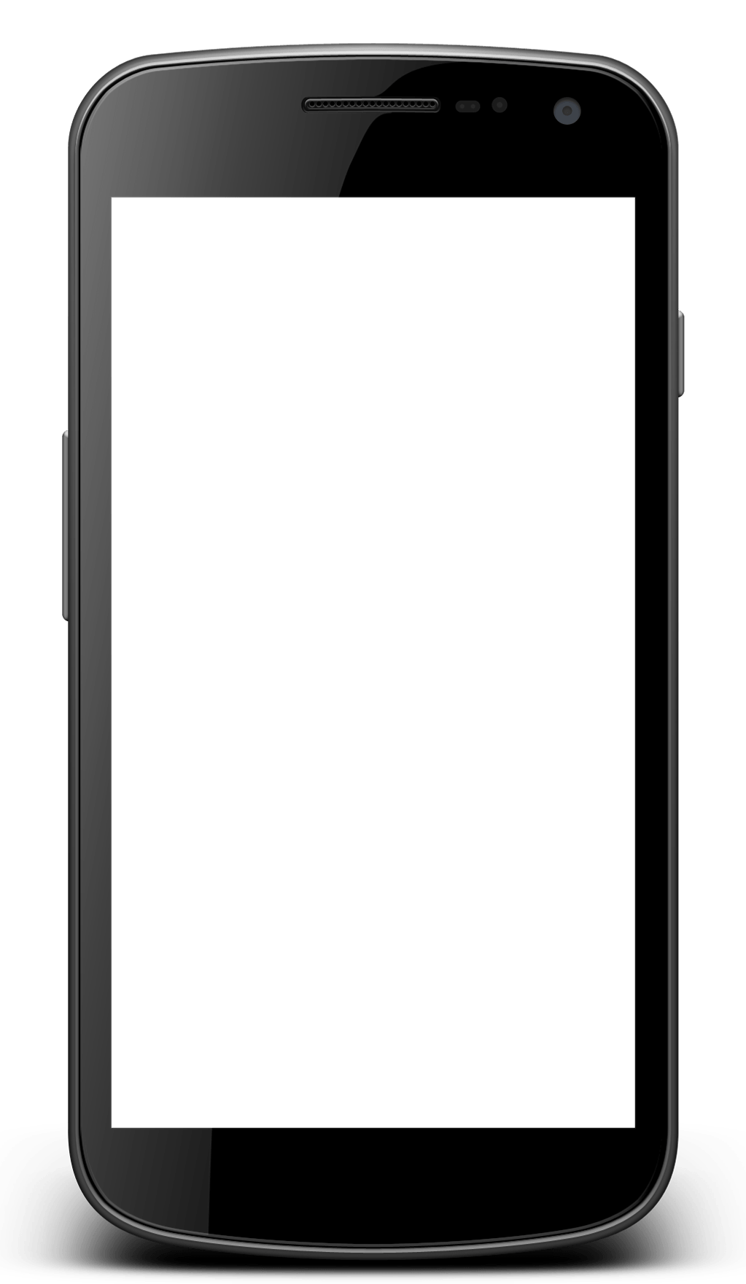
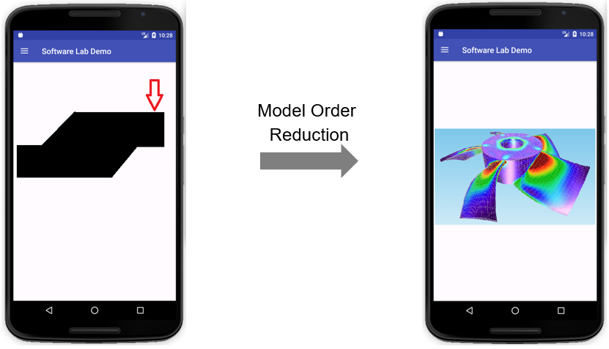
Where did we start?
We started from the very beginning…
Our Task is…
Create a 2D - FEM framework that runs on a wide range of Android devices
Guide user intuitively from Geometry Creation to Post-Processing
Provide a Model Order Reduction Method to solve models more efficiently and be able to solve more complex (bigger) systems
BE FAST

Slide 6
Design Pattern: Model View Controller
GUI (user)
VIEW
Provides user interface
Renderer tool
Update UI
CONTROLLER
Receives user actions, and updates model and view
Android activities
User Actions
Manipulate Model
Independent from each other
Parallel development
No global effect due to local changes
Easy management of complex application
Notify Change
MODEL
Contains computational parts
FEM package

Slide 7
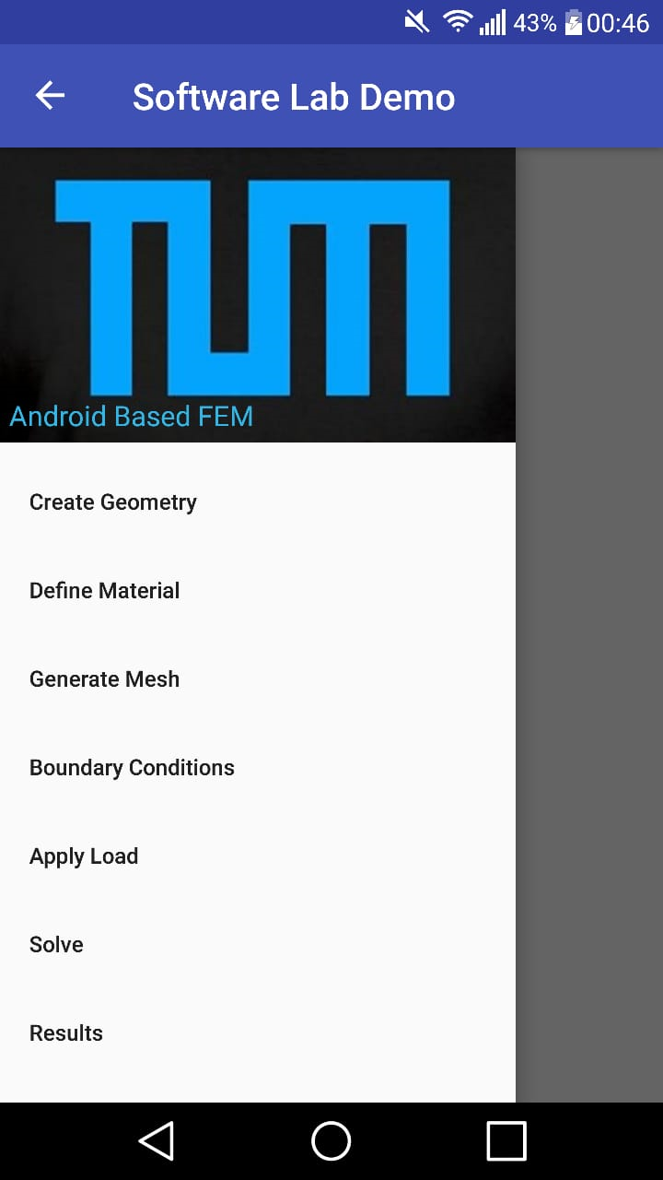
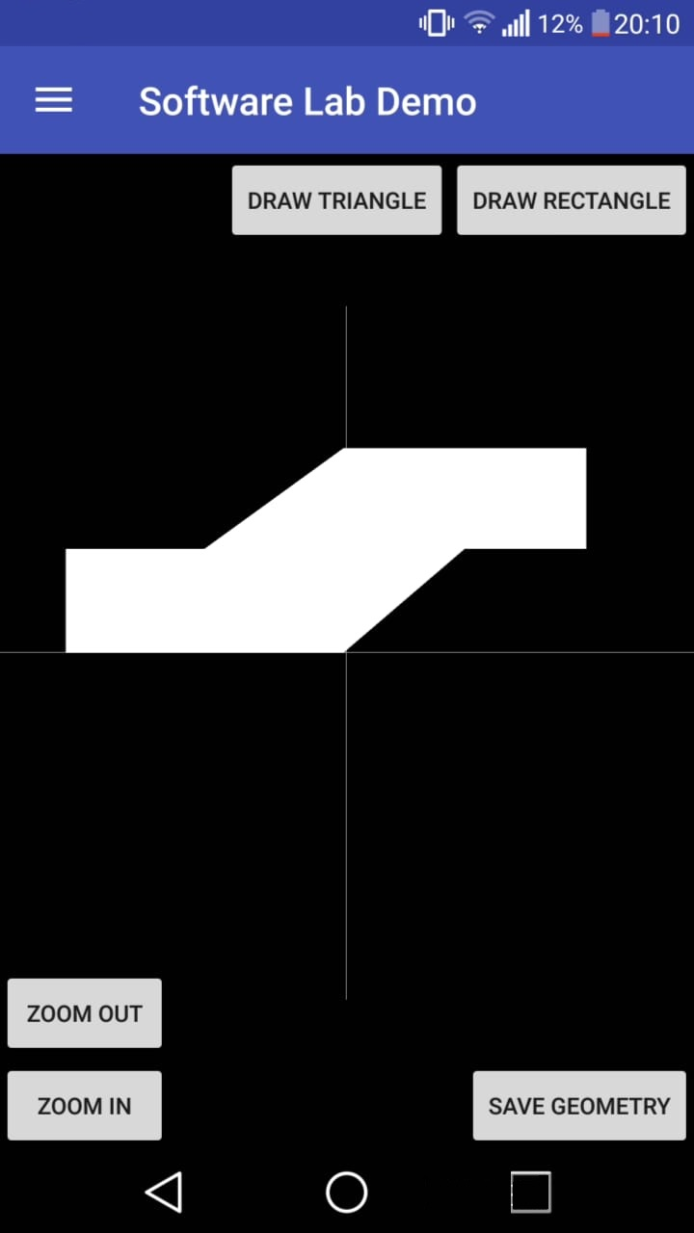
Model View Controller
Handle User Actions
Navigate User
Update Renderer Tool

Slide 8


Model View Controller
CPU
GPU
Open Graphics Library is an Application Programming Interface (API) for rendering 2D and 3D vector graphics
Well suited for our Application as it is language independent
Architecture is based on a client-server model
Client
Server
APP
(Java Code)
Shader
(GLSL Code)
*fragment shader
*vertex shader
Window Interface
OpenGL Library
Frame Buffer
Image
Events

Slide 9
Model View Controller
FEM Package
Implement Libraries with C++
Two options are available
Implement Libraries with Java

Slide 10


Model View Controller
FEM Package
Package Codded in C++
Advantages
Faster Code (Carefull Implementation)
Garbage Collector not always friend
Cross Platform Development
Small memory footprint
Room for future implementations
Disadvatages
Need development time
Existing implemantations are heavy to implement directly
Package Codded in Java
Advantages
Compact app-oriented code
Relatively faster implementation time
Disadvatages
Compactness comes with a price
FEM part will be blended with android environment.

Slide 11

Model View Controller
FEM Package

Slide 12
Model View Controller
FEM Package
Try C++ Option
Start Java Library
Finish Fem Package
Implement MOR Models
Go for 2 weeks
Anything Goes Wrong?
June
July
August
Fine?
Finish & Test
C++ Library
Implement MOR Models

Slide 13

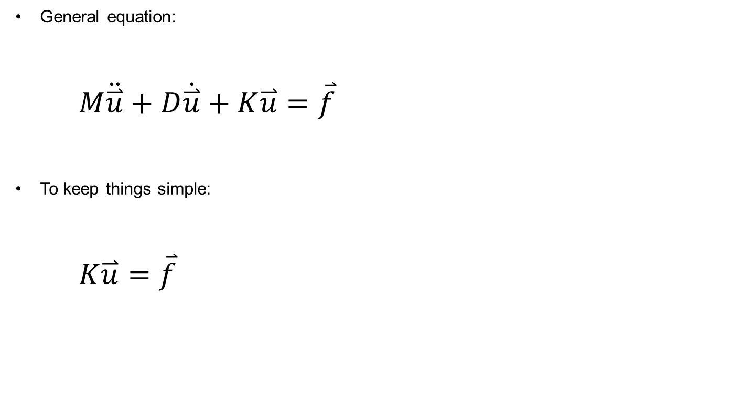


MOR Package
General equation:
$M\ddot{\overset{⃑}{u}}+D\dot{\overset{⃑}{u}}+K\overset{⃑}{u}=\overset{⃑}{f}$
To keep things simple:
$K\overset{⃑}{u}=\overset{⃑}{f}$
$$Nx1$$
$$Nx1$$
$$NxN$$

Slide 14
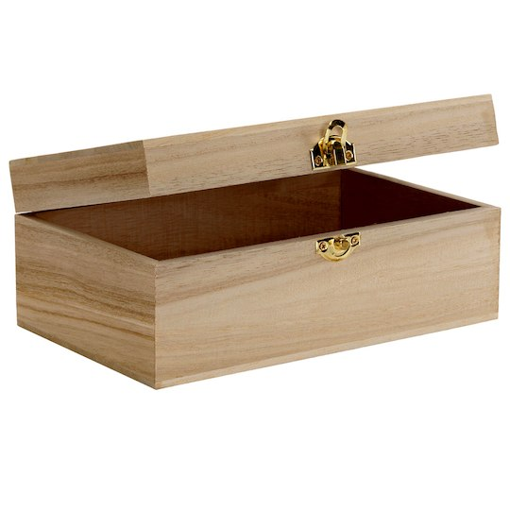



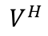


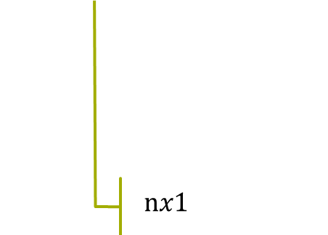
MOR Package
We need a magic box
$$\overset{⃑}{u}$$
$${\overset{⃑}{u}}_{r}$$
$${\overset{⃑}{f}}_{r}$$
$$\overset{⃑}{f}$$
$$V$$
$$V^{H}$$
$$nx1$$

Slide 15
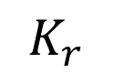
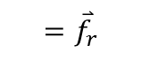
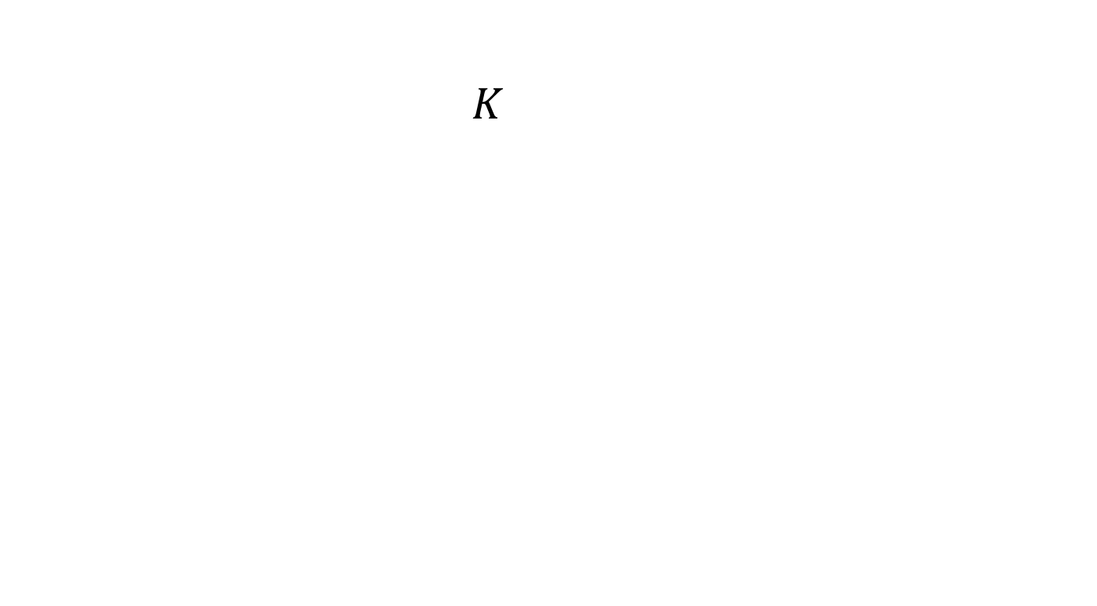
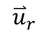
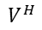

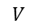

MOR Package
$K$
$${=\overset{⃑}{f}}_{r}$$
$${\overset{⃑}{u}}_{r}$$
$$V^{H}$$
$$V$$
$$K_{r}$$
$nxn$ where $n≪N$
$$K_{r}{\overset{⃑}{u}}_{r}={\overset{⃑}{f}}_{r}$$

Slide 16
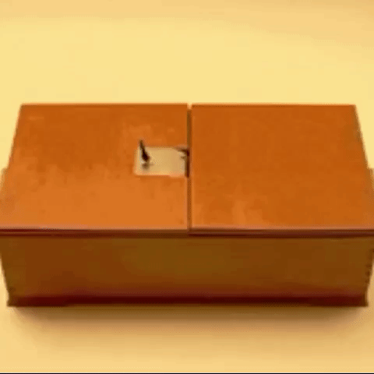
MOR Package

Slide 17
Work Plan
Done
Get familiar with the Android Development Environment
Construct Android application layout
Make rendering framework available
To - Do
Implement the FEM-Package (C++ or Java)
Implement a Model Order Reduction method
Add further features to the application (e.g. geometry types, elements types… )

Slide 18
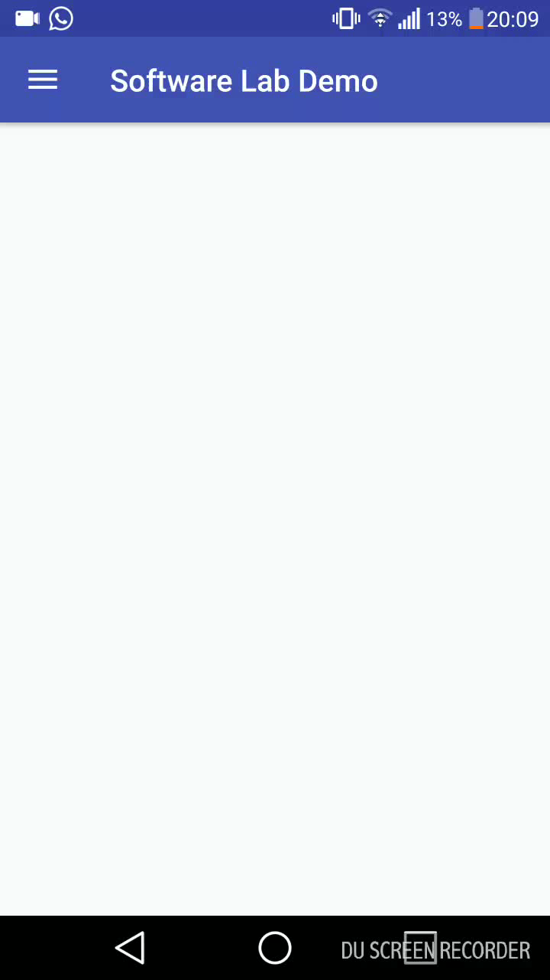
Thanks for your Attention

